Slide 1
Machine Learning and Data Science
SAMUEL JOSHUA
1IC21AI027
IMPACT COLLEGE OF
ENGINEEING
Internship carried out at Karunadu Technologies Private Limited

Slide 2

The company offers broad range of customized software applications powered by concrete technology and industry expertise.
It also offers end to end embedded solutions and services.
They deal with broad range of product development along with customized features ensuring at most customer satisfaction and also empower individual with knowledge, skills and competencies that assist them to escalate as integrated individuals with a sense of commitment and dedication
Company
Profile

Slide 3
Vision
To Empower unskilled Individual with Knowledge, skills and Technical competences in the field of Information Technology and embedded engineering which assist them to escalate as integrated individuals contributing to company’s and National growth

Slide 4
Provide cost effective and reliable solutions to customers across various latest technologies.
Offer scalable end-to-end application development and management solutions
Provide cost effective highly scalable products for varied verticals.
Focus on creating sustainable value growth through innovative solutions and unique paternships
Create, design and deliver business solutions with high value and innovation by leveraging technology expertise and innovative business models to address long- term business objectives.
Keep our products and services updated with the latest innovations in the respective requirement and technology.
Missions

Slide 5
To develop software and Embedded solutions and services focussing on quality standards
and customer values.
Offer end to end embedded solutions which ensure the best customer satisfaction.
To build Skilled and Talented manpower pool for global industry requirements.
To develop software and embedded products which are globally recognized.
To become a global leader in Offering Scalable and cost-effective Software solutions and services across various domains like E-commerce, Banking, Finance, Healthcare and much more.
To generate employment for skilled and highly talented youth of our Country
INDIA.
Objectives

Slide 6
Python
HTML
Django
Machine Learning
Machine learning algorithms
Linear regression
Multiple regression
Logistic regression
K-Nearest Neighbour(KNN)
Support Vector Machine(SVM)
Decision tree
Topics learnt during internship

Slide 7
Project name : Galactic Astral Identification
Problem statement: Create a machine learning model to predict whether the person will diagnose for diabetes or not by entering the input details by providing a data set as input to the model
Algorithm used : Naive Bayes
Inputs:
alpha
delta = Declination angle
u = Ultraviolet filter
g = Green filter
r = Red filter
i = Near Infrared filter
z = Infrared filter
run_ID = Run Number
rereun_ID = Rerun Number
cam_col = Camera column
field_ID = Field number
spec_obj_ID = Unique ID
redshift = redshift value
plate = plate ID
MJD = Modified Julian Date\
fiber_ID
class = object class
Outputs:

Slide 8
The data consists of 100,000 observations of space taken by the SDSS :
• alpha = Right Ascension angle (at J2000 epoch)
• delta = Declination angle (at J2000 epoch)
• u = Ultraviolet filter in the photometric system
• g = Green filter in the photometric system
• r = Red filter in the photometric system
• i = Near Infrared filter in the photometric system
• z = Infrared filter in the photometric system
• run_ID = Run Number used to identify the specific scan
• rereun_ID = Rerun Number to specify how the image was processed
• cam_col = Camera column to identify the scanline within the run
• field_ID = Field number to identify each field
• spec_obj_ID = Unique ID used for optical spectroscopic objects (this means that 2 different observations with the same spec_obj_ID must share the output class)
• class = object class (galaxy, star or quasar object)
• redshift = redshift value based on the increase in wavelength
• plate = plate ID, identifies each plate in SDSS
• MJD = Modified Julian Date, used to indicate when a given piece of SDSS data was taken
• fiber_ID = fiber ID that identifies the fiber that pointed the light at the focal plane in each observation
About datasets

Slide 9
Import the required library (here pandas and sklearn)
Provide the path of data file so that it can be included in our program
Analyze the given data set
Clean the data
Remove null value if any
Drop the columns and rows which are not needed
Encode the string using map() function
Divide the data frame into inputs and output as per the problem statement
Create a model by importing linear model from sklearn
Train the model using fit() function
Provide the input and let the model predict the output
Calculate the accuracy of the model using confusion matrix or by using accuracy score()
Also create the front end using Django
Steps used in data analysis

Slide 10
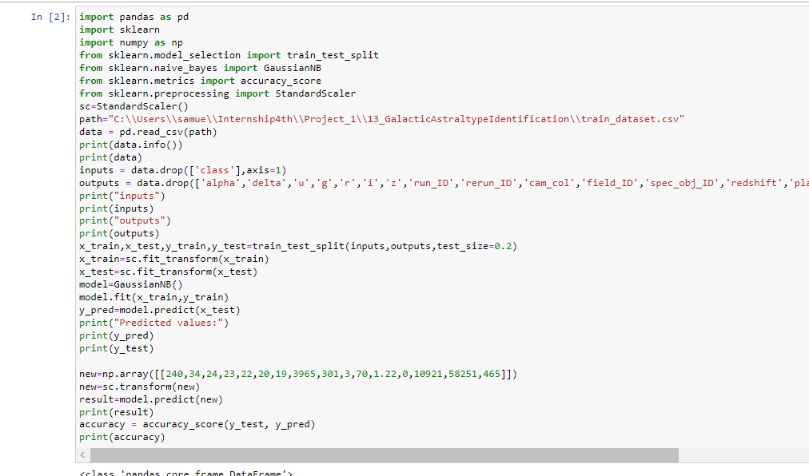
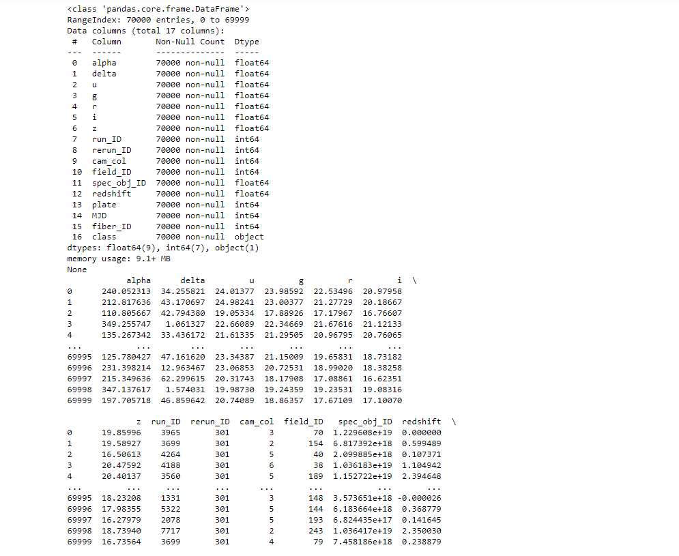

Slide 11
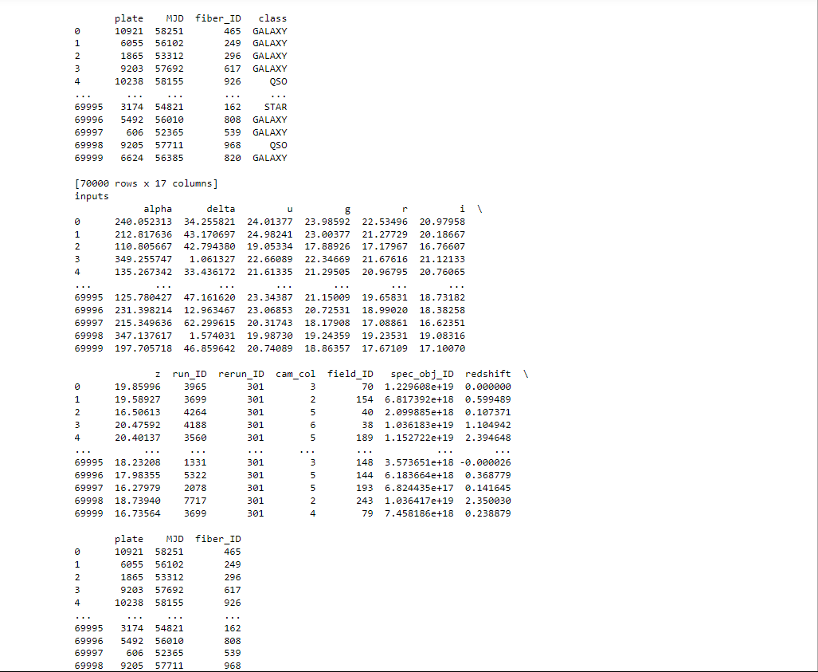
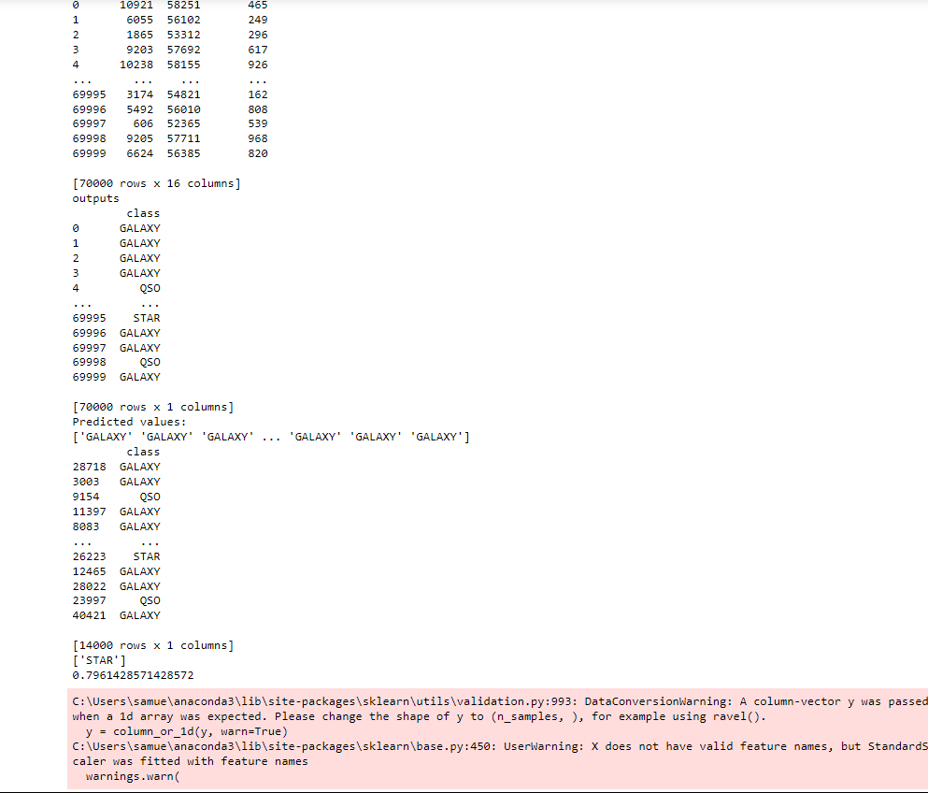

Slide 12
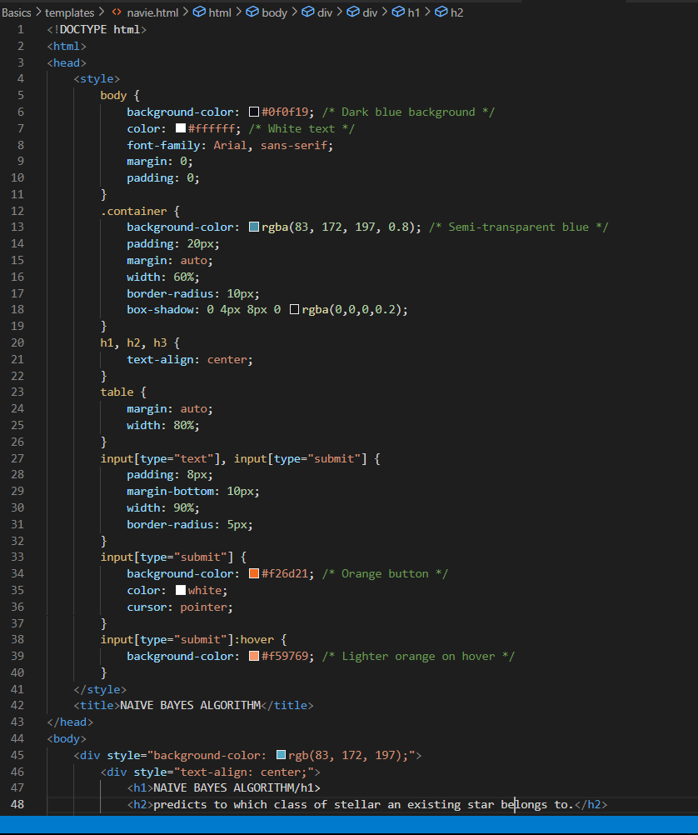
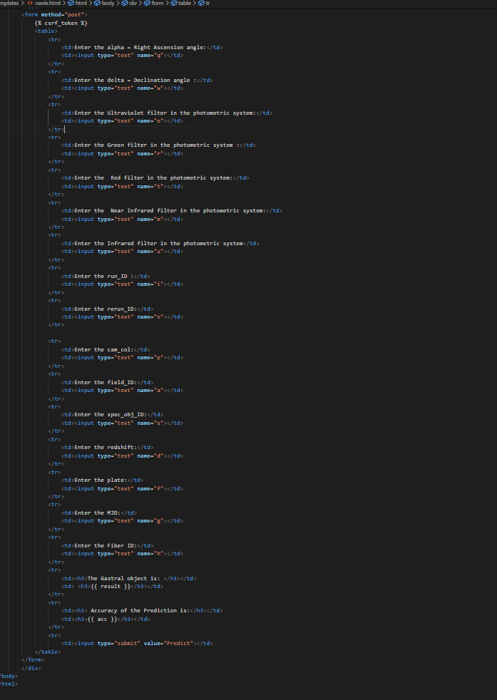

Slide 13
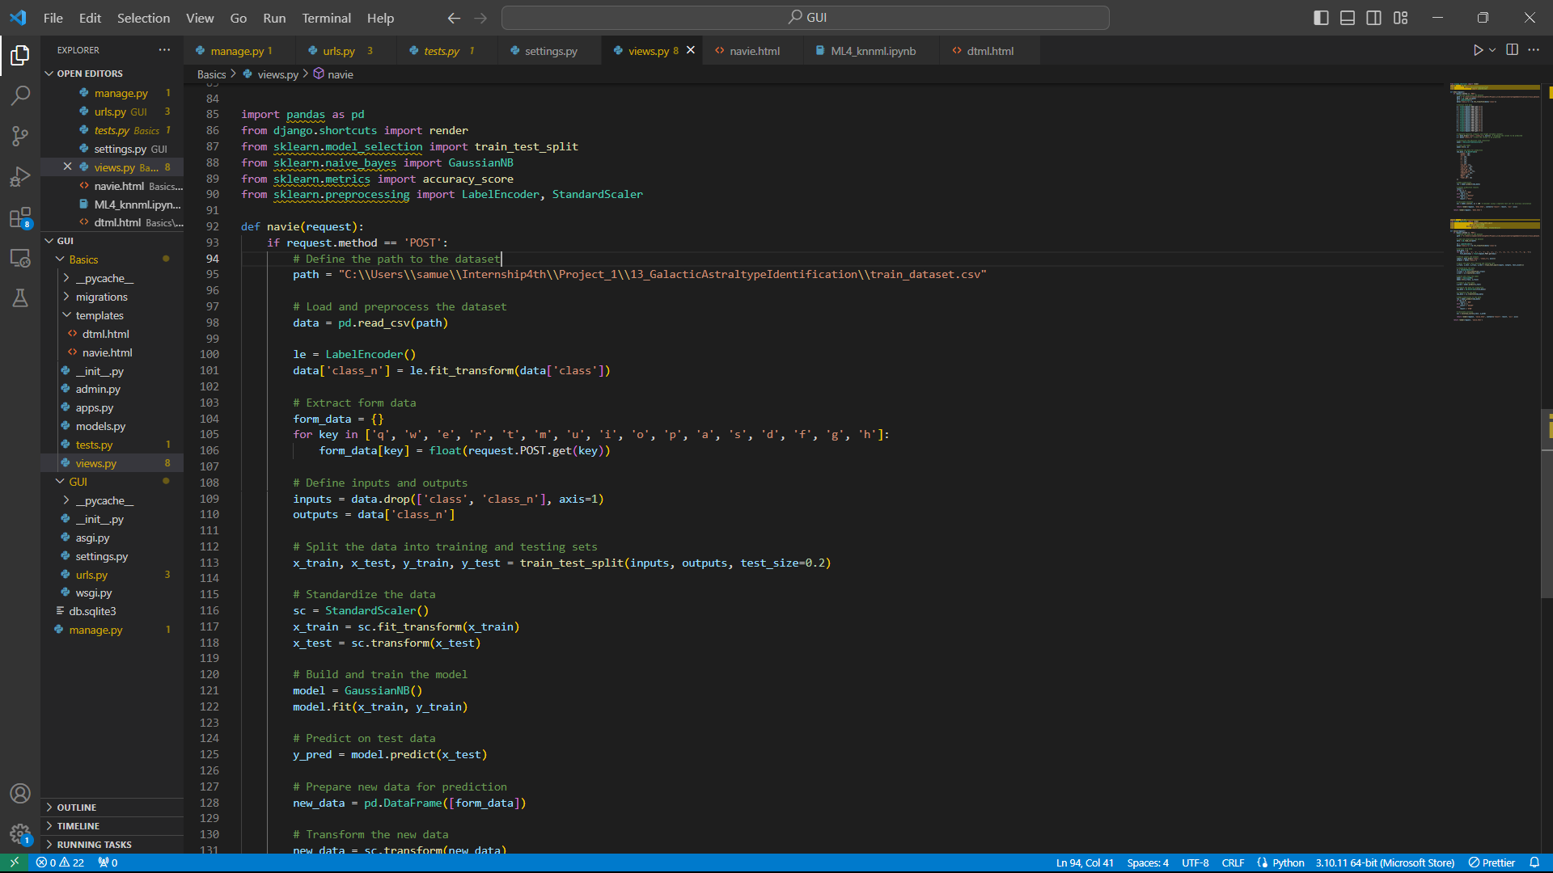

Slide 14
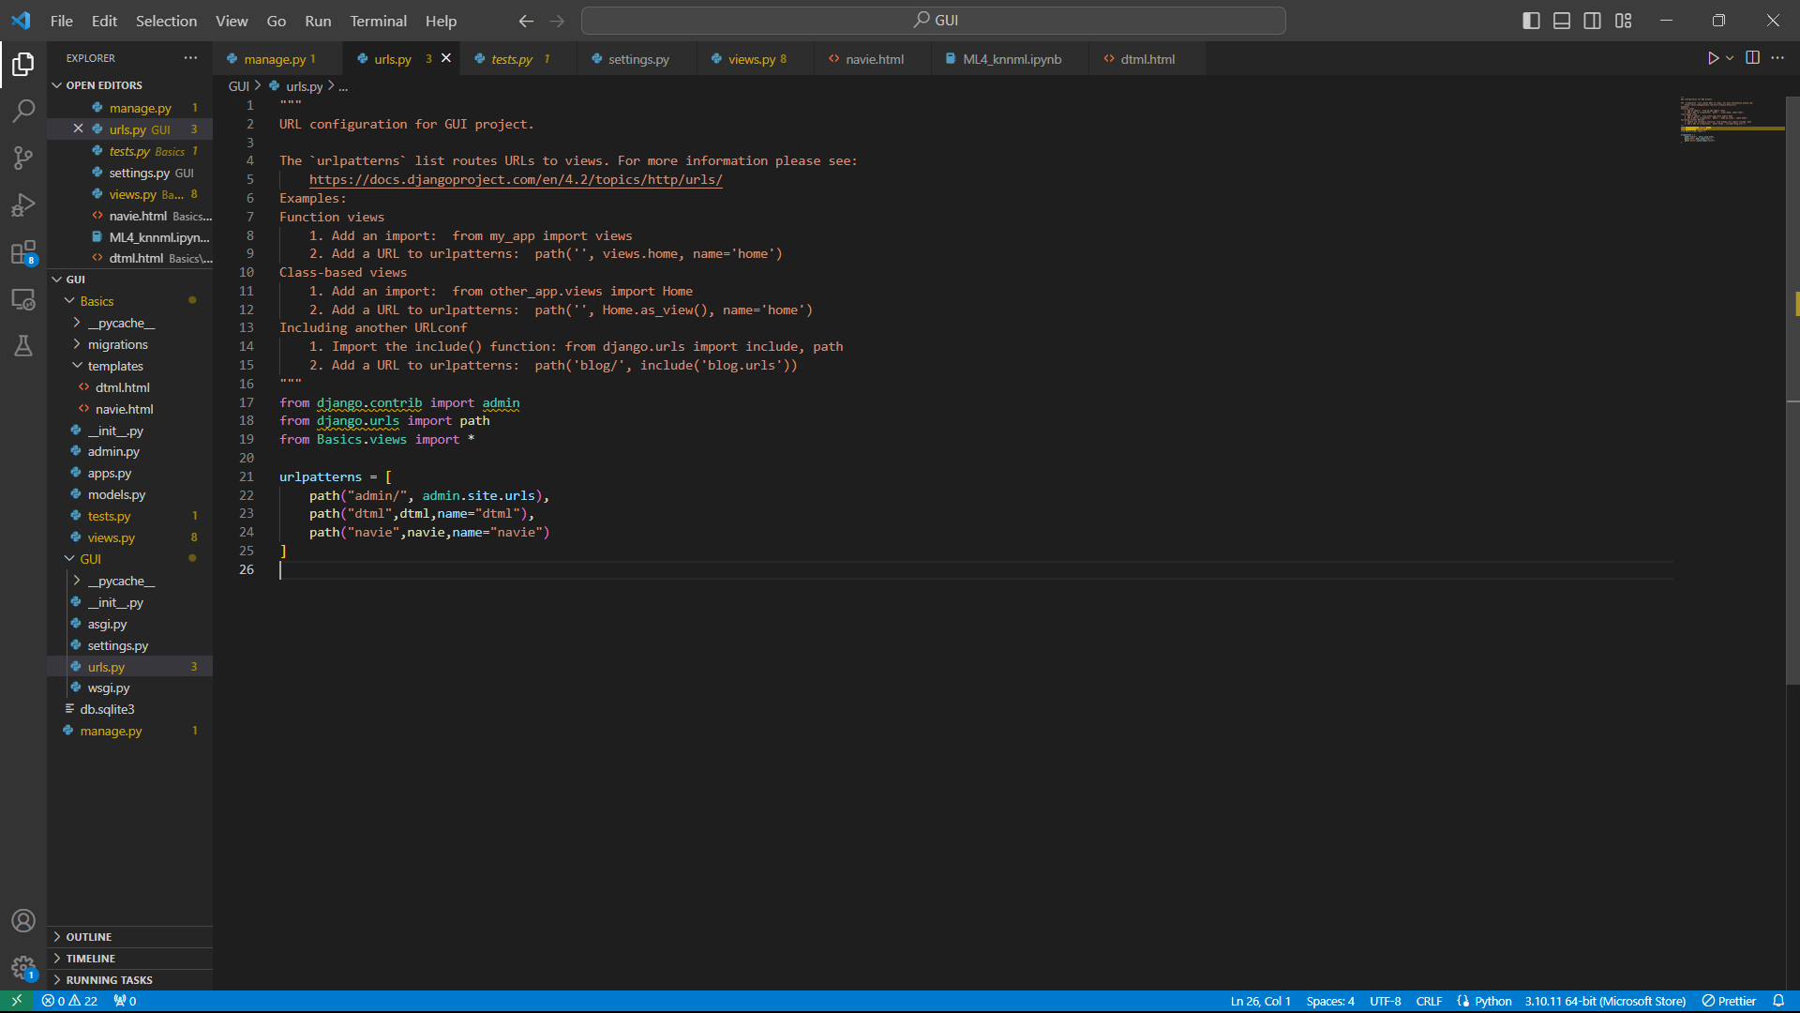

Slide 15
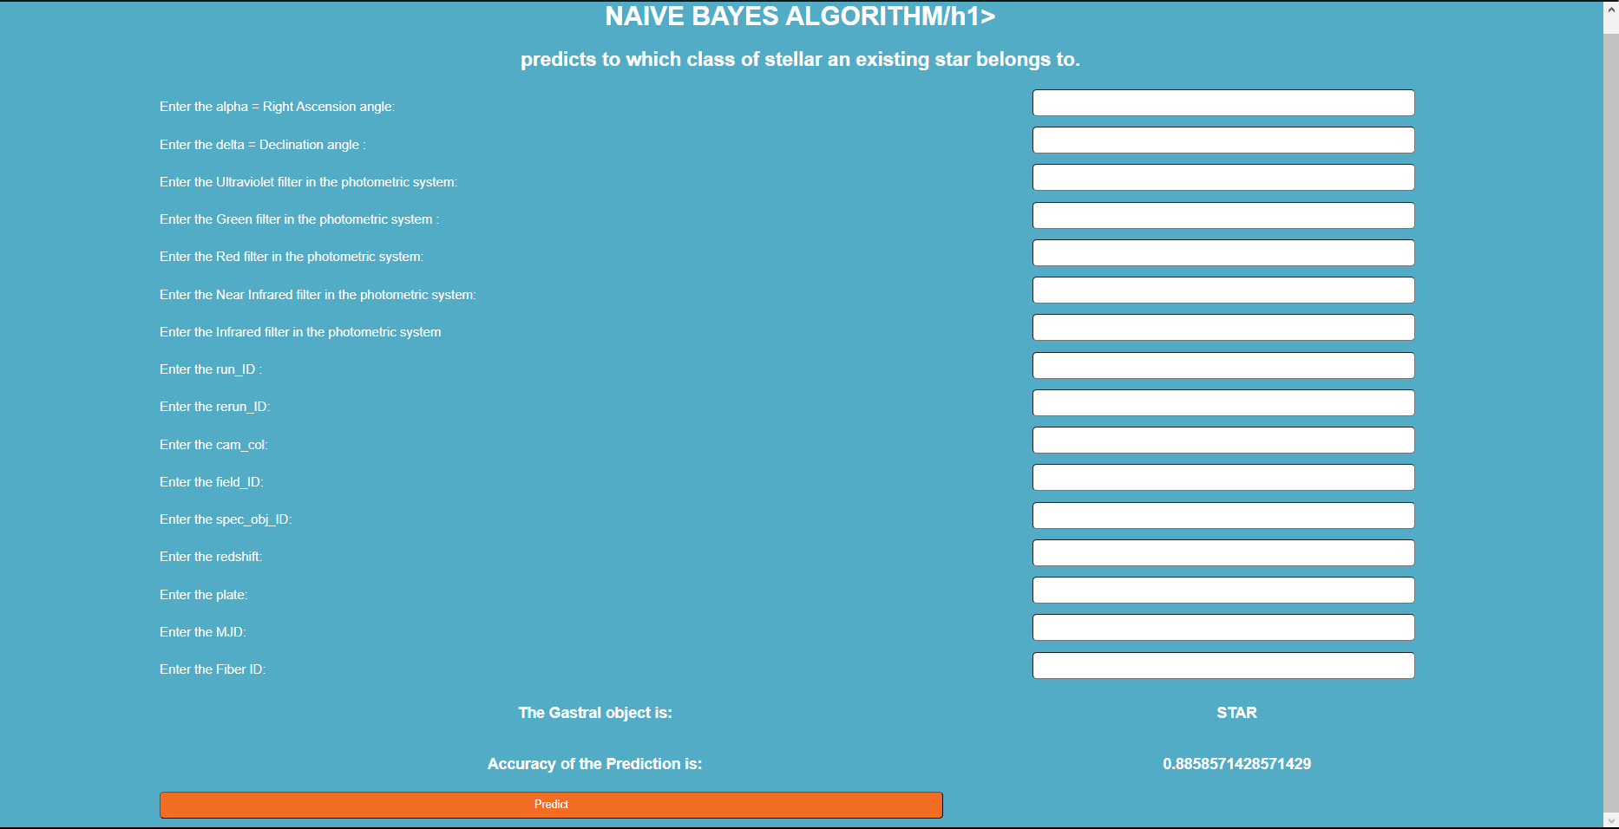
Output

Slide 16
Project name : Galactic Astral Identification
Problem statement: Create a machine learning model to predict whether the person will diagnose for diabetes or not by entering the input details by providing a data set as input to the model
Algorithm used : Decision Tree
Inputs:
alpha
delta = Declination angle
u = Ultraviolet filter
g = Green filter
r = Red filter
i = Near Infrared filter
z = Infrared filter
run_ID = Run Number
rereun_ID = Rerun Number
cam_col = Camera column
field_ID = Field number
spec_obj_ID = Unique ID
redshift = redshift value
plate = plate ID
MJD = Modified Julian Date\
fiber_ID
class = object class
Outputs:

Slide 17
The data consists of 100,000 observations of space taken by the SDSS :
• alpha = Right Ascension angle (at J2000 epoch)
• delta = Declination angle (at J2000 epoch)
• u = Ultraviolet filter in the photometric system
• g = Green filter in the photometric system
• r = Red filter in the photometric system
• i = Near Infrared filter in the photometric system
• z = Infrared filter in the photometric system
• run_ID = Run Number used to identify the specific scan
• rereun_ID = Rerun Number to specify how the image was processed
• cam_col = Camera column to identify the scanline within the run
• field_ID = Field number to identify each field
• spec_obj_ID = Unique ID used for optical spectroscopic objects (this means that 2 different observations with the same spec_obj_ID must share the output class)
• class = object class (galaxy, star or quasar object)
• redshift = redshift value based on the increase in wavelength
• plate = plate ID, identifies each plate in SDSS
• MJD = Modified Julian Date, used to indicate when a given piece of SDSS data was taken
• fiber_ID = fiber ID that identifies the fiber that pointed the light at the focal plane in each observation
About datasets

Slide 18
Import the required library (here pandas and sklearn)
Provide the path of data file so that it can be included in our program
Analyze the given data set
Clean the data
Remove null value if any
Drop the columns and rows which are not needed
Encode the string using map() function
Divide the data frame into inputs and output as per the problem statement
Create a model by importing linear model from sklearn
Train the model using fit() function
Provide the input and let the model predict the output
Calculate the accuracy of the model using confusion matrix or by using accuracy score()
Also create the front end using Django
Steps used in data analysis

Slide 19
Import the required library (here pandas and sklearn)
Provide the path of data file so that it can be included in our program
Analyze the given data set
Clean the data
Remove null value if any
Drop the columns and rows which are not needed
Encode the string using map() function
Divide the data frame into inputs and output as per the problem statement
Create a model by importing linear model from sklearn
Train the model using fit() function
Provide the input and let the model predict the output
Calculate the accuracy of the model using confusion matrix or by using accuracy score()
Also create the front end using Django
Steps used in data analysis

Slide 20
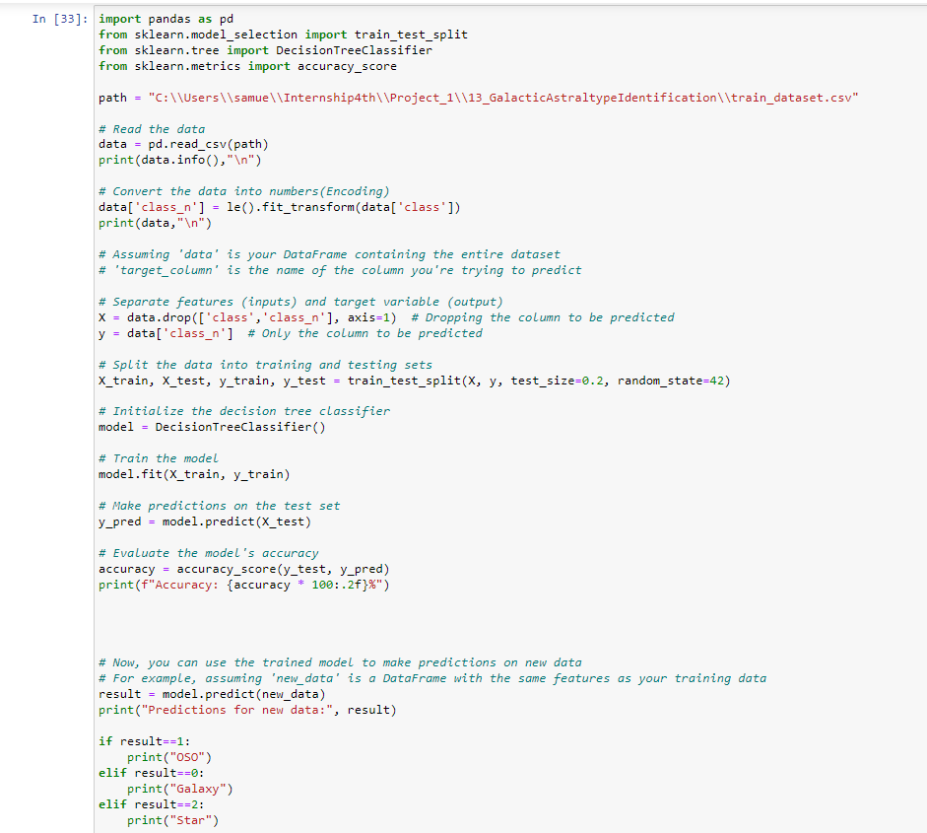
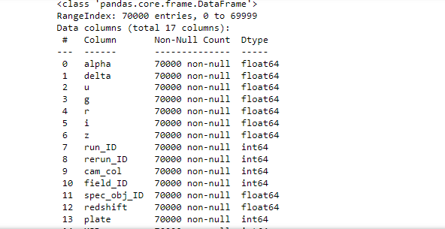
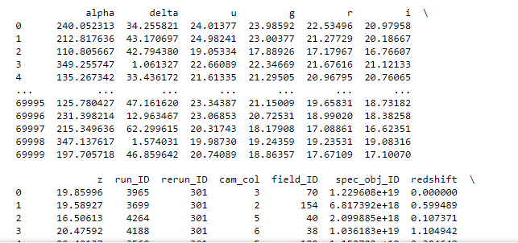

Slide 21
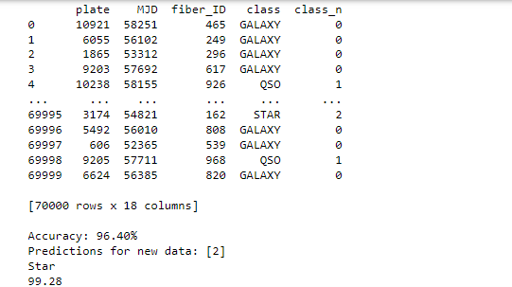

Slide 22
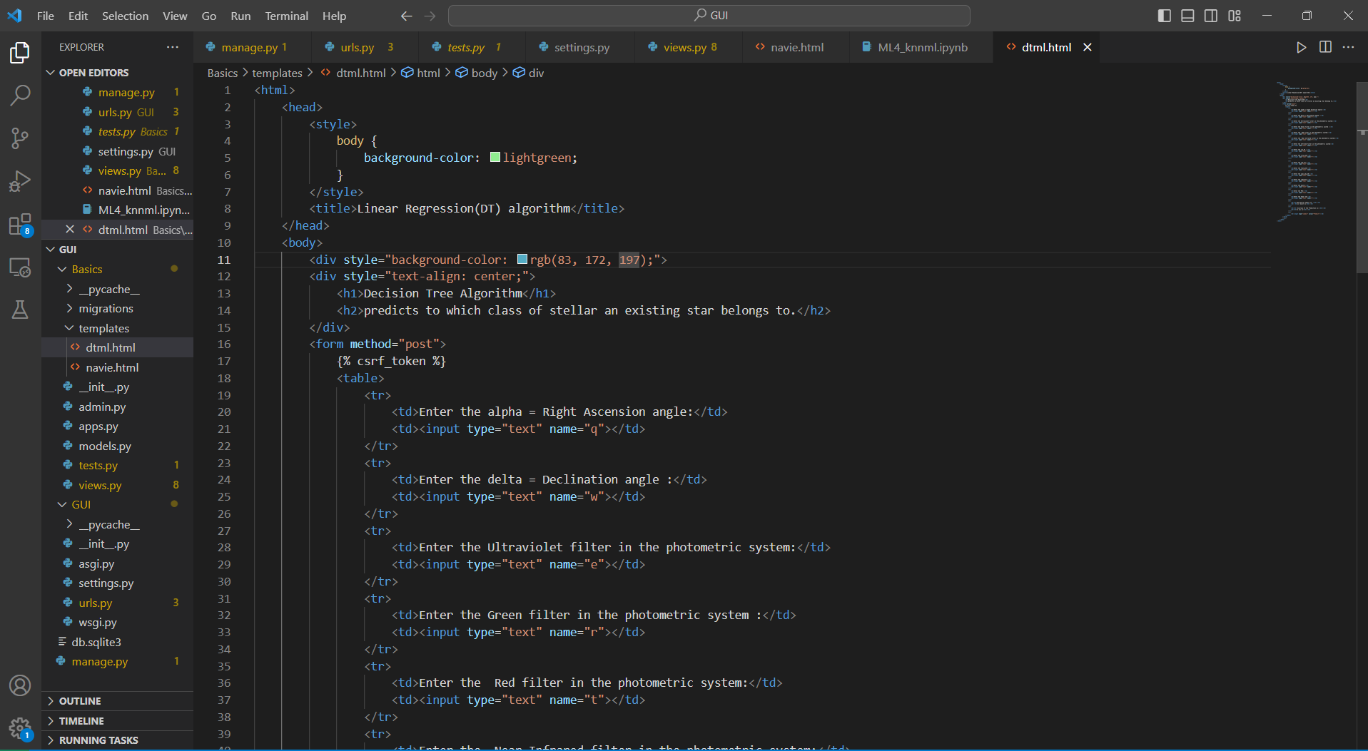

Slide 23
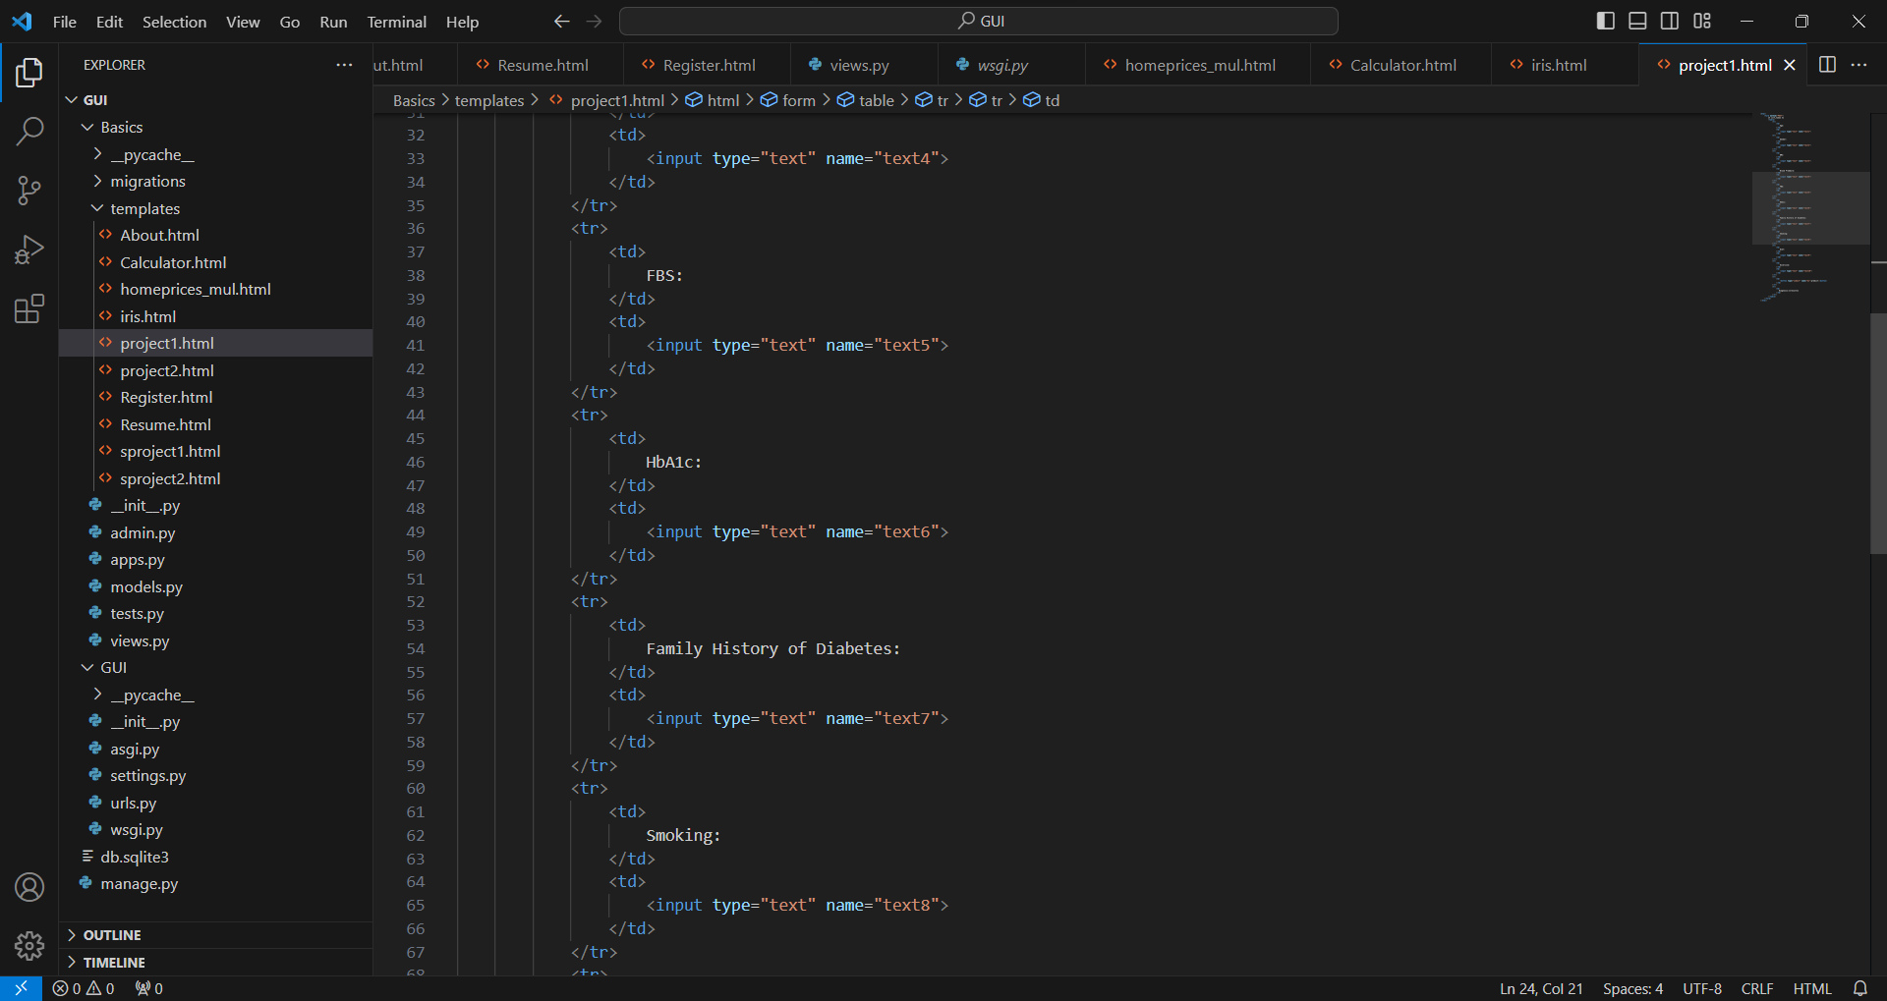

Slide 24
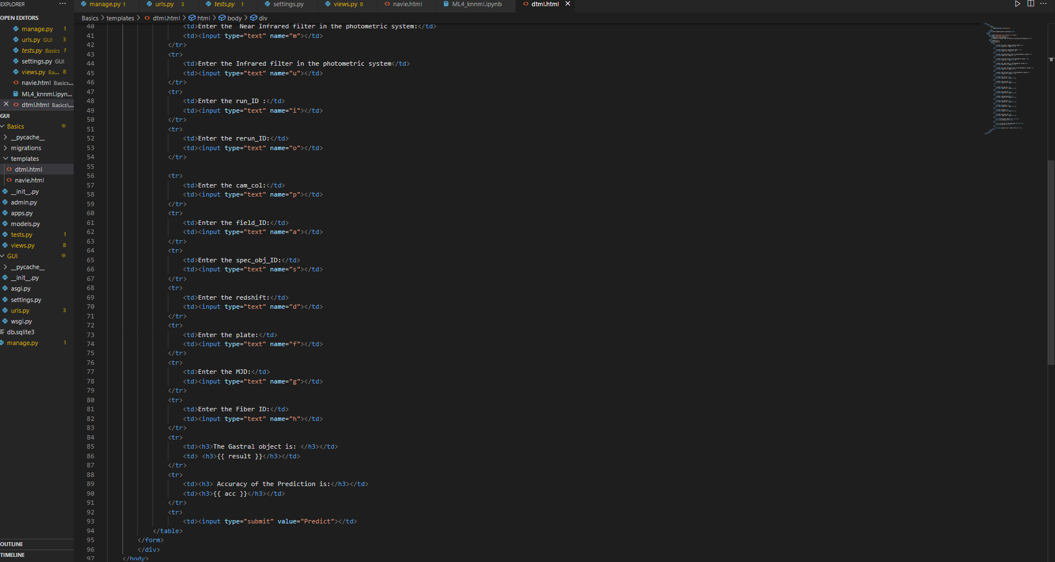

Slide 25
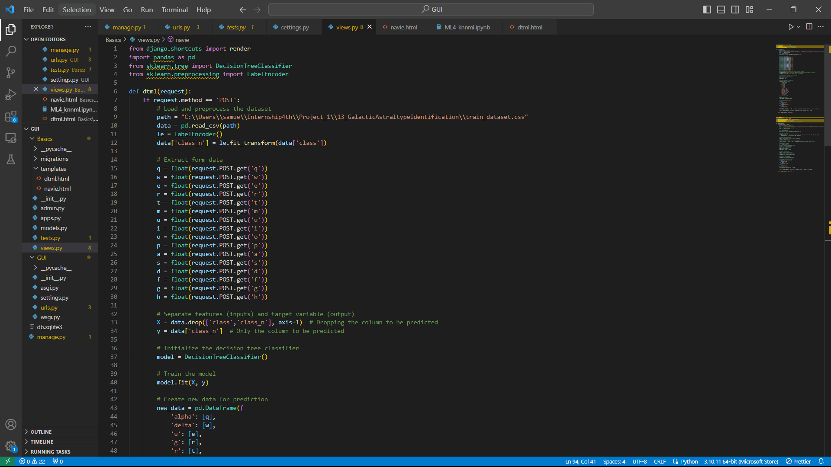

Slide 26
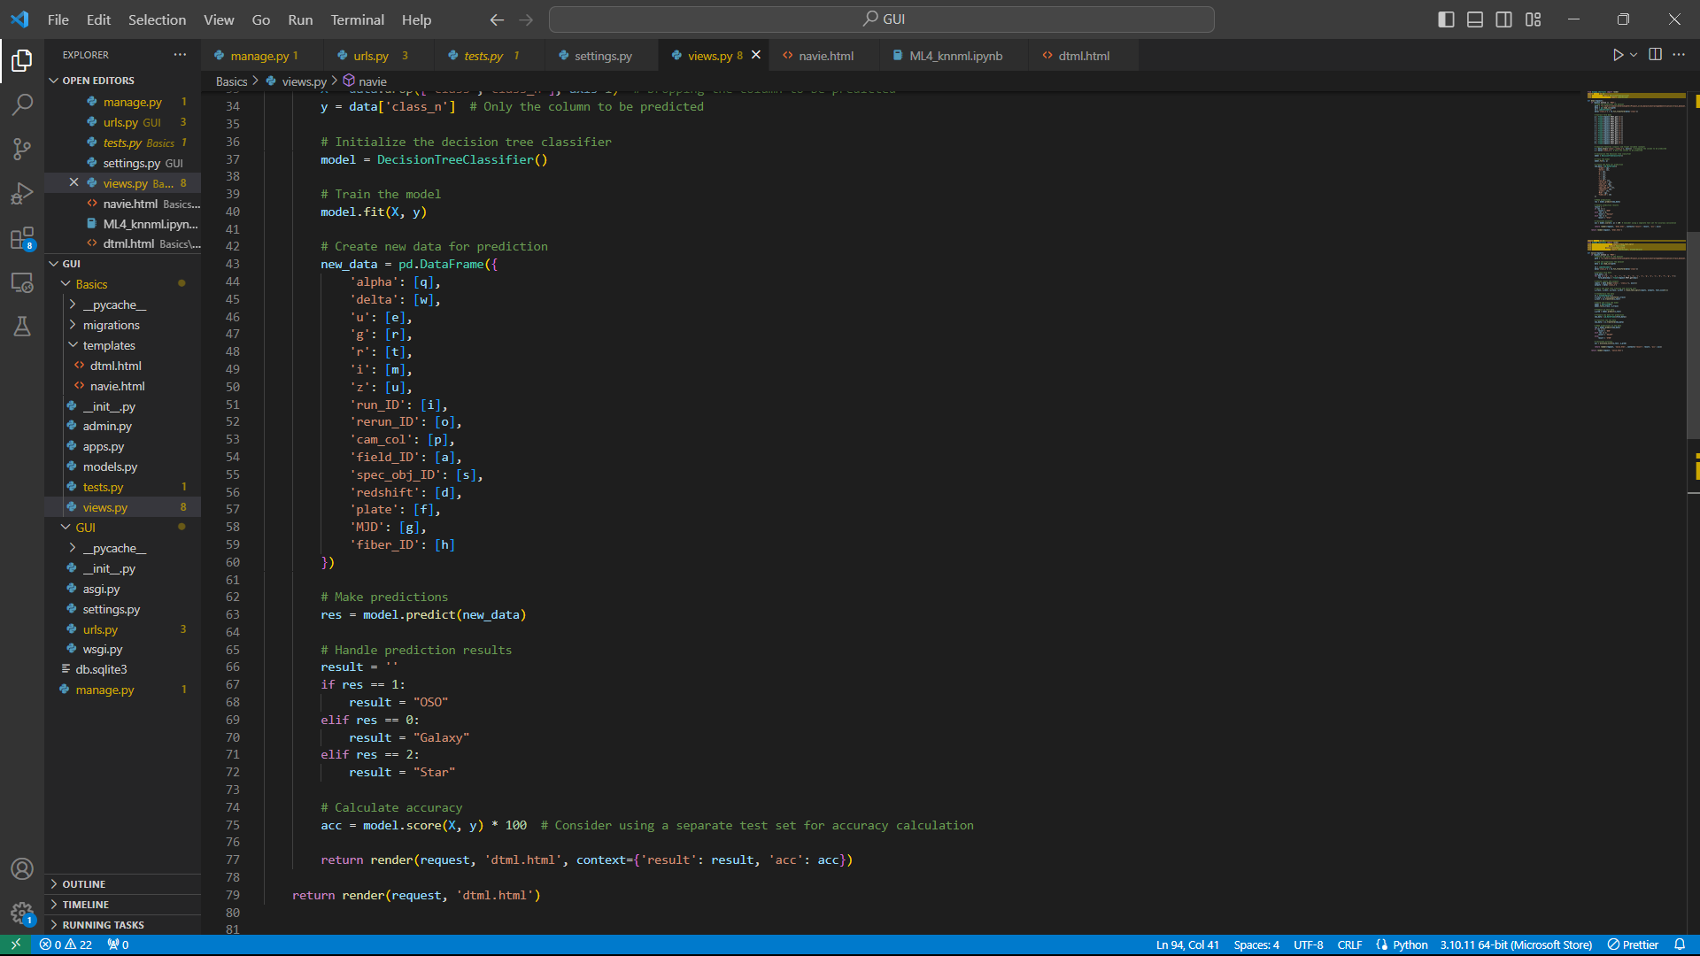

Slide 27


Slide 28
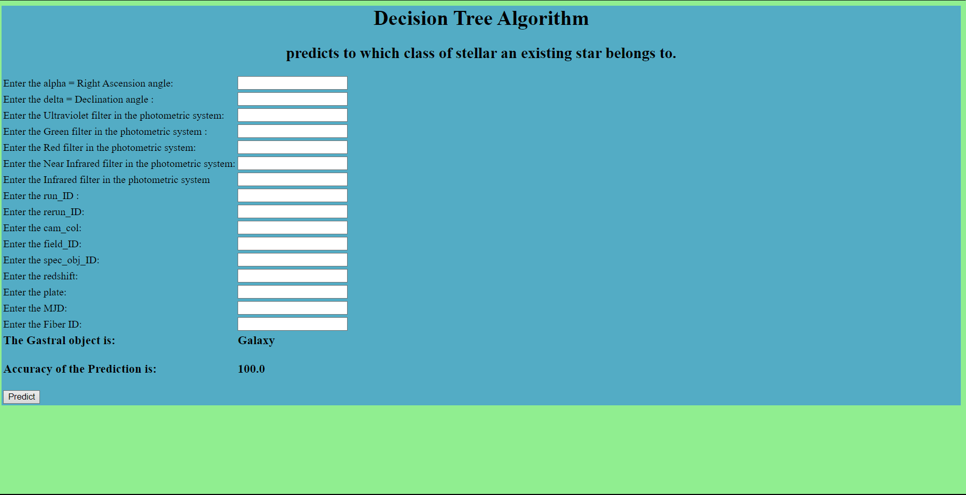
Output

Slide 29
Thank You

